Slide 1
Navigating through the
General Services Statewide Price Agreement
Due to the pandemic and inflation, prices have increased dramatically leaving grantees short on their original purchase requests appropriations.

Slide 2

Problems We’re Facing
Prices have increased since the grant was applied for.
Vendors can’t deliver goods by term date of grant agreement.
Chassis for hot/cold food trucks have a waiting period of 1-year.
Micro bird vehicles are inflated by 20K over original quoted prices.
Vendor does not have vehicle in stock.
There are back orders on chips, glass and other vehicle parts.
This Photo by Unknown Author is licensed under CC BY-SA
It used to be 50K! What happened?

Slide 3
NM State Purchasing Statewide price agreements
Verify with your procurement department if state-wide price agreement can be used, as some bylaws will not allow the use.
Go to the website provided below to access State Purchasing Division’s “Facilitating Fair and Open Competition” page and follow the navigation steps provided in the next few slides.
Website: https://www.generalservices.state.nm.us/state-purchasing/

Slide 4
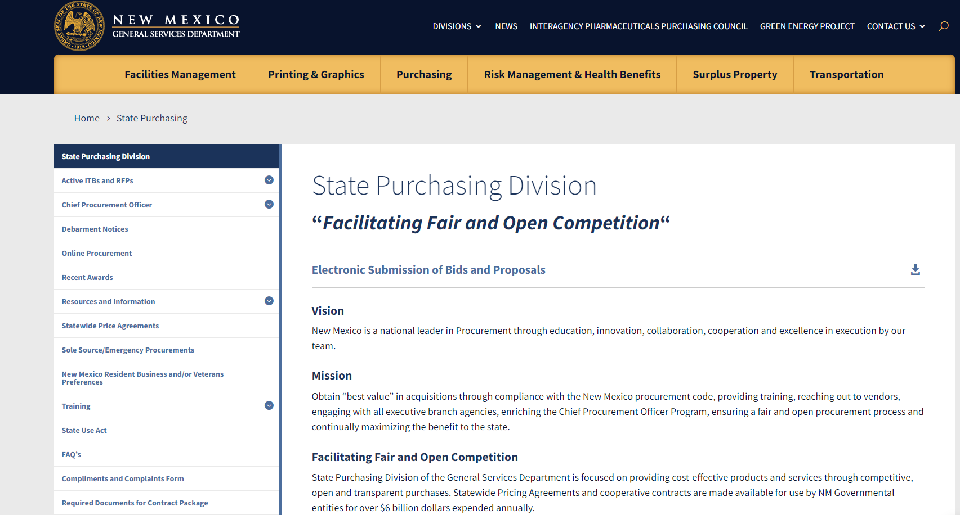
Once you are at the website, this is what you should see

Slide 5
Click on Statewide Price Agreements

Slide 6
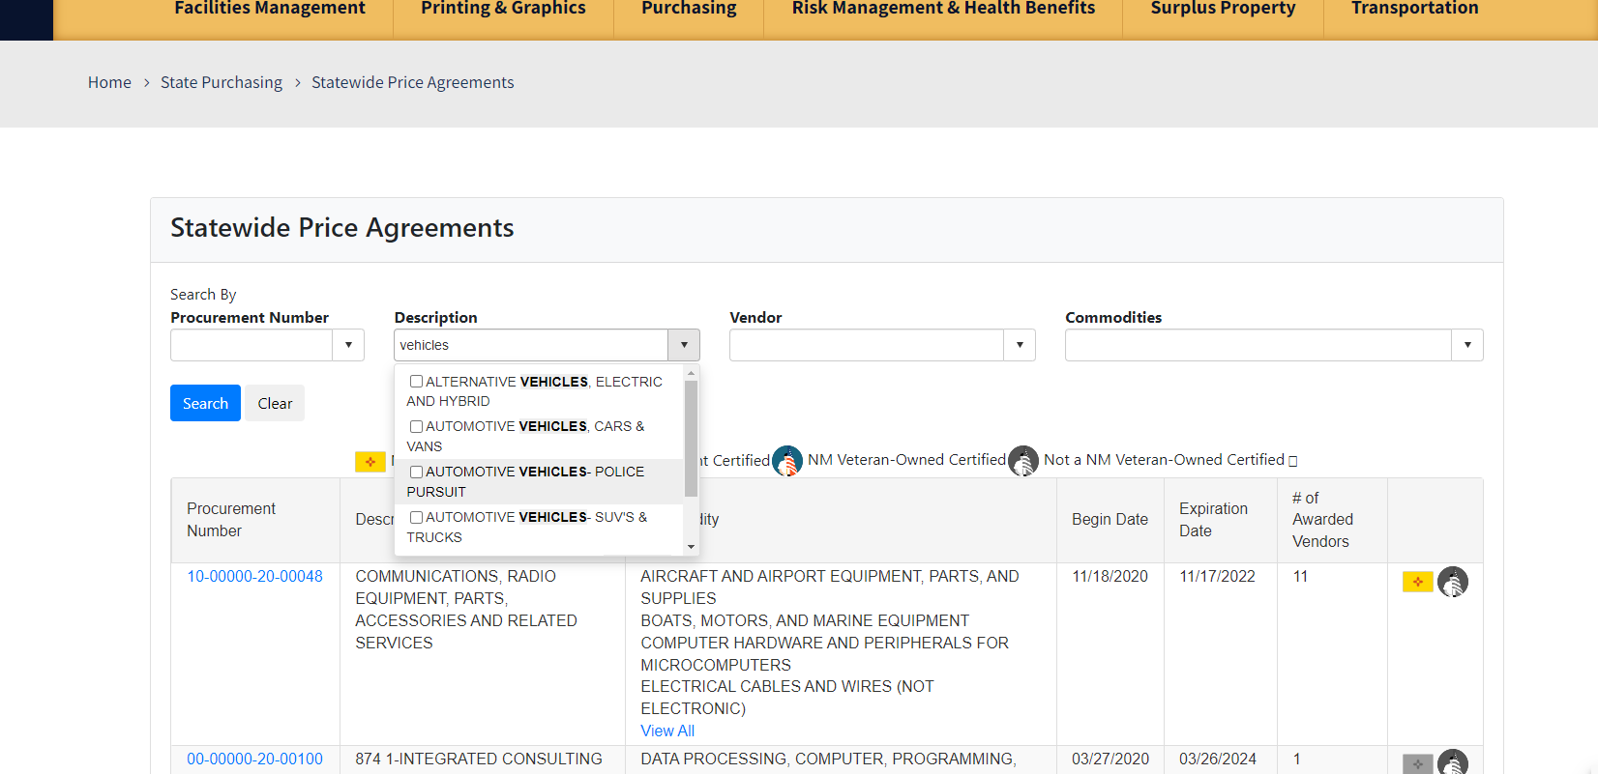
In description box, scroll down to find vehicle type

Slide 7
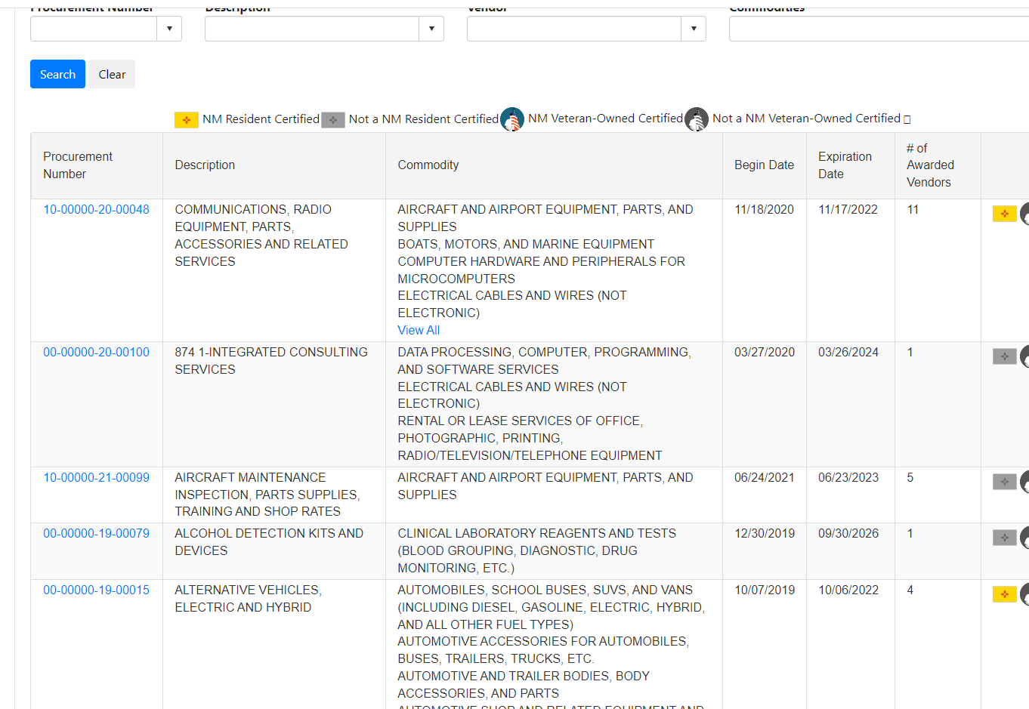
Scroll down to see the listed vendors for vehicles

Slide 8
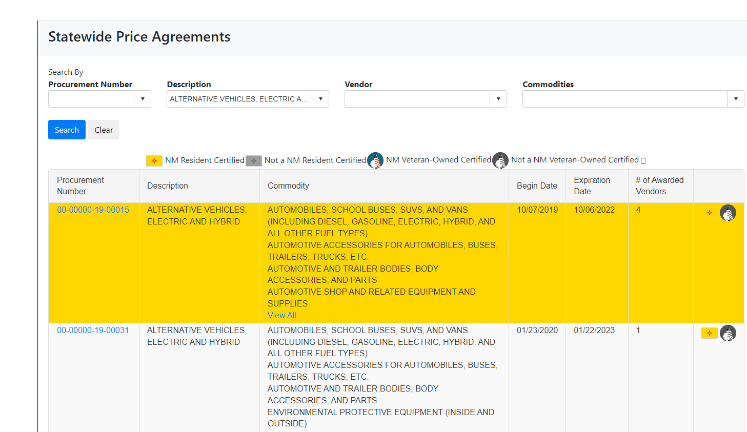
Click the procurement number to open and read price agreement

Slide 9
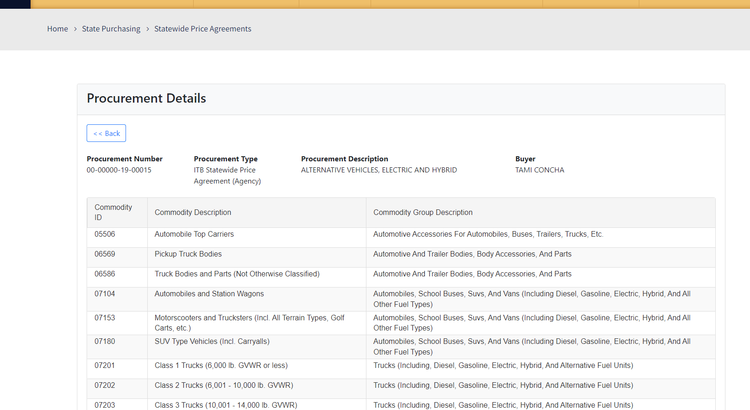
Scroll down and see awarded vendors

Slide 10
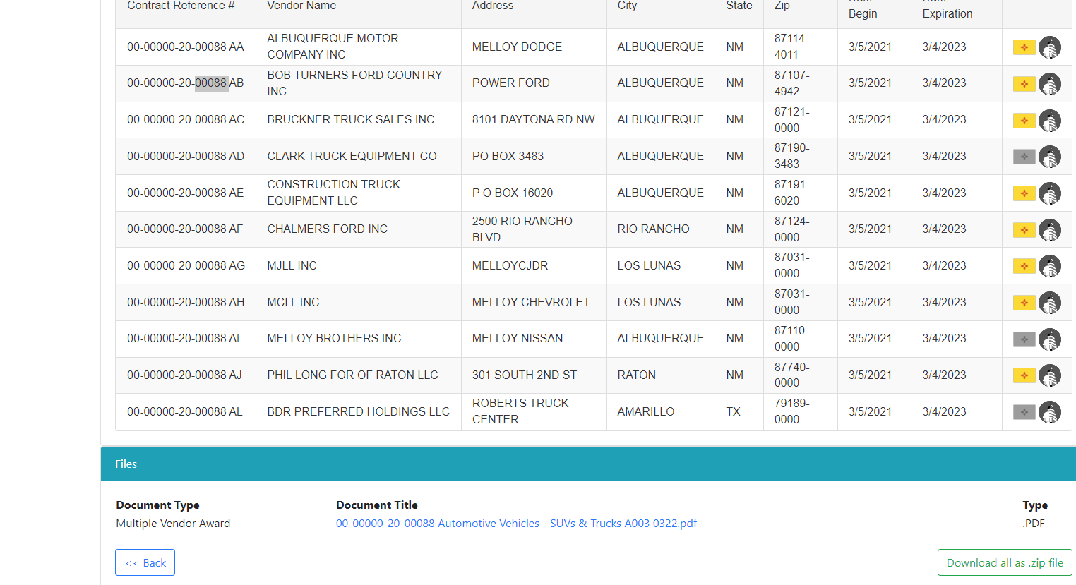
Select document and left click to open price agreement

Slide 11
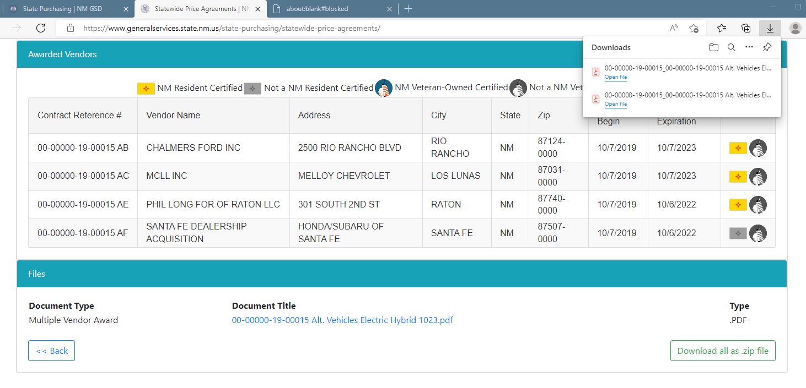
Right click to open price agreement

Slide 12
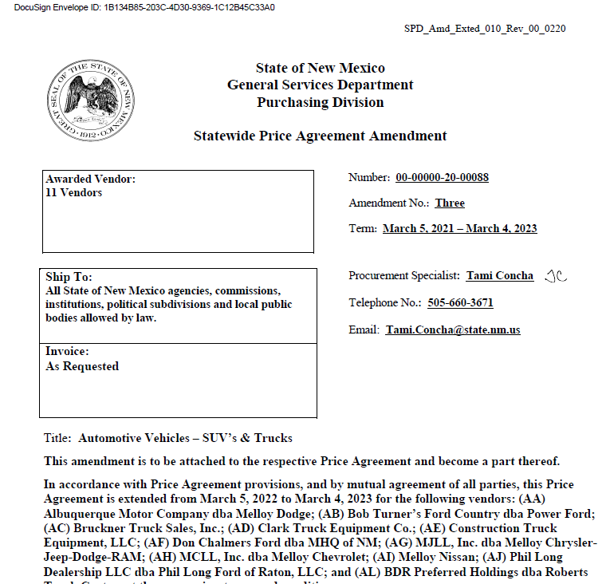
You are now in the price agreement

Slide 13
The above arrows point to:
Number of Vendors on the contract.
Name of Procurement Specialist who facilitated agreement.
The Term dates, from the awarded contract date, to the end of contract date.
Note: Usually before the contract runs its term, State Purchasing Department will need to set up another ITB or RFP to get a new contract established for the next 4-years. You may contact the Procurement Specialist to find out if another ITB or RFP is being established if the term date is near and you will not be able to utilize the existing agreement.

Slide 14
State Purchasing can answer any questions
For questions on the price agreement or assistance navigating through the agreement, contact the specific Procurement Specialist, who’s name is listed on the right-hand corner of the Price Agreement. See the red arrows found on the previous slide.
The Capital Outlay Bureau can help with any of your questions, concerns, and guidance. Please reach out to us.
Barbara.Romero@state.nm.us Bureau Chief 505.365.3660
Elizabeth.Chavez@state.nm.us Project Coordinator 505.365.3804
Connie.Garcia2@state.nm.us Project Coordinator 505.372.9104
Ernest.Saavedra@state.nm.us Financial Coordinator 505.490.3367

