Slide 1
Navigating through the
Cooperative Educational Services (CES)

Slide 2
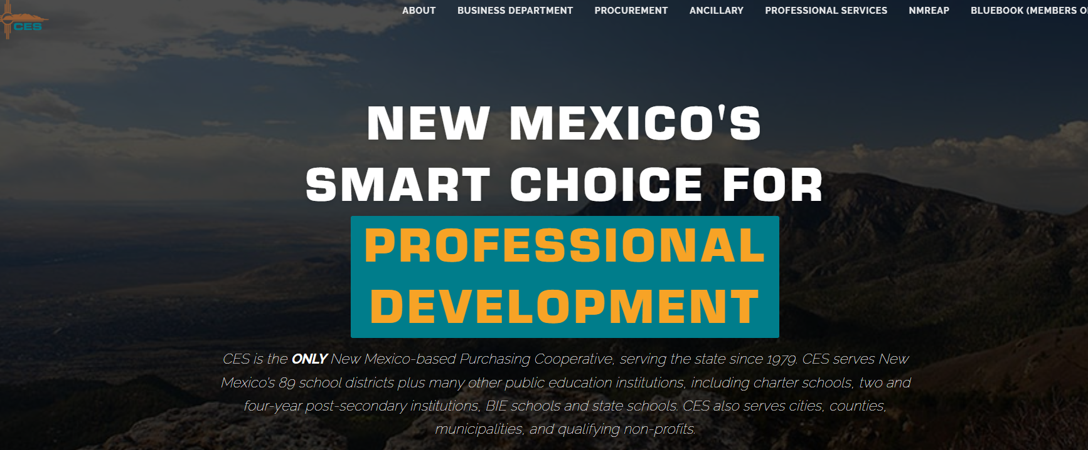
1. Go to wwwces.org

Slide 3
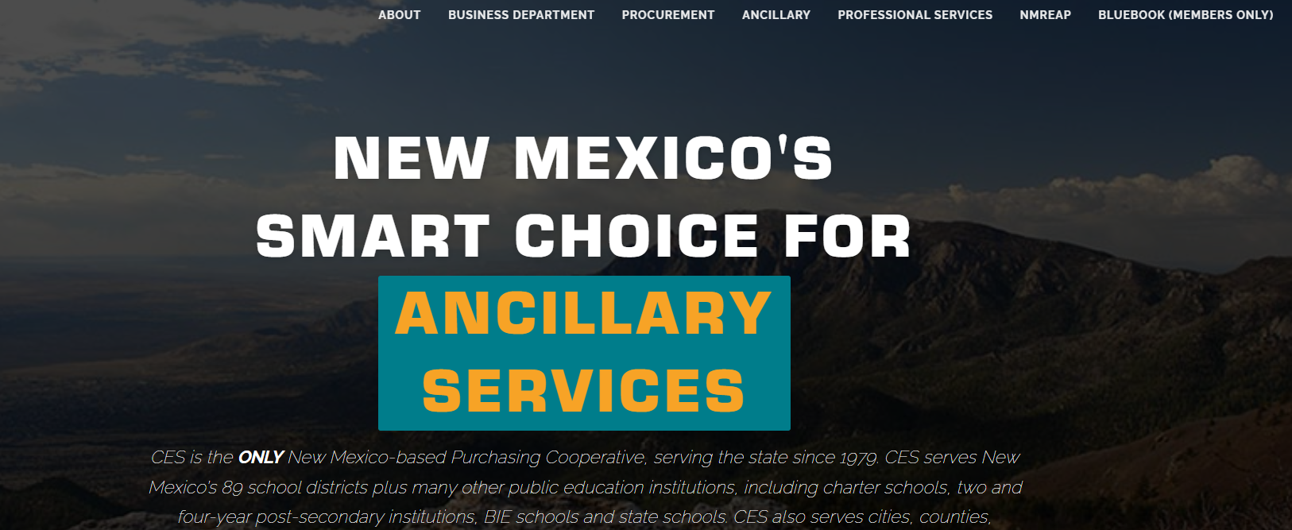
2. In the upper right-hand corner, select
"Bluebook (for members only)"

Slide 4
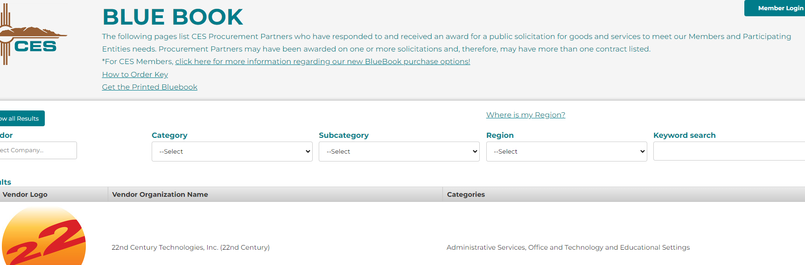
3. Select Turquoise "member Log in" button in upper right.

Slide 5
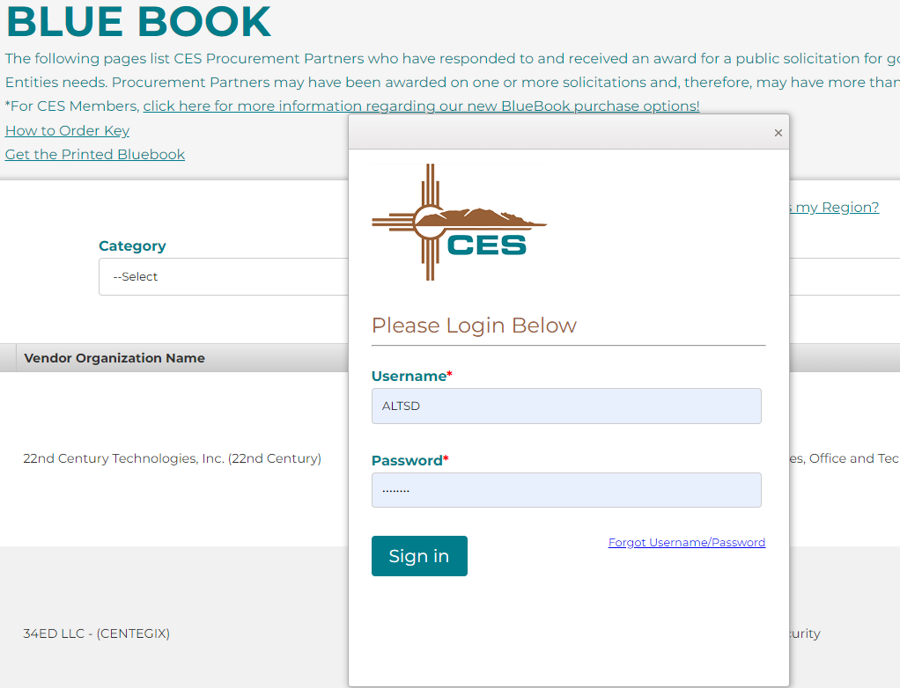
4. On the Log-in screen, type in
a. User Name ALTSD
b. Password CES1979!

Slide 6
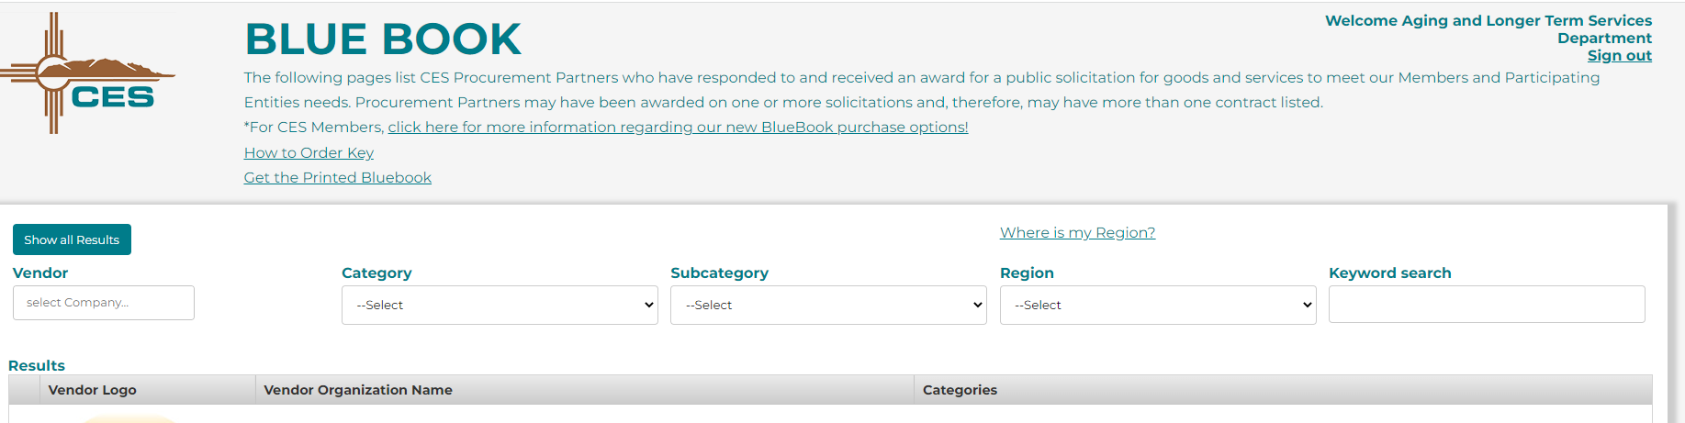
5. Once you are in, the bluebook will say

Slide 7
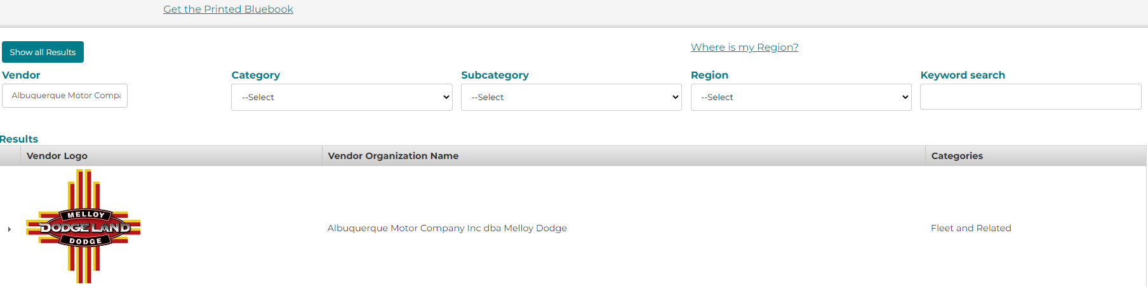
6. You can now begin navigating through the bluebook to find vendors you might contact for various purchases you seek to complete.
  a. If you want to see if a particular vendor is there, you can type the name in the "vendor" box in upper left.
  b. The Category and Sub-Category search options are very efficient.

Slide 8
Category and Subcategory
For example, if you are looking for a general contractor for renovation you can:
  1. Select Construction Services in the Category box
  2. Select General Construction in Subcategory
  3. This will give you a list
  4. If you want to make sure they are contracted to work in your region, you can determine your region by clicking on the "where is my region" link above the "region" search box (next slide shows what comes up when you click the link)

Slide 9
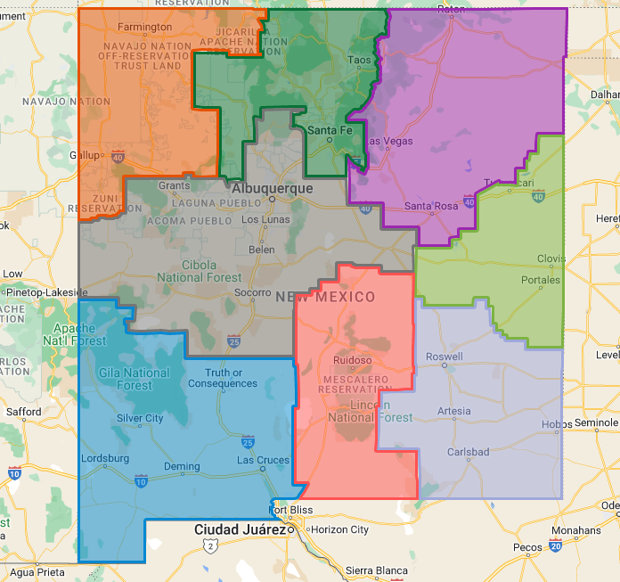
Find your region- (Link above search box)

Slide 10
Regions
        Orange is Region 1 (Northwest Corner)
        Dark Green is Region 2 (North Central)
        Purple is Region 3 (Northeast Corner)
        Dark Grey is Region 4 (Central Region)
        Light Green is Region 5 (East Central)
        Dark Grey is Region 6 (Southeast Corner)
        Red is Region 7 (South Central)
        Blue is Region 8

Slide 11
Categories and Subcategories cont.
5. Once you have determined your region, there are two ways of determining if a vendor contract serves your region
a. You can select your region in the search box, along with the category and subcategories.
b. Or, you can look at the contract number(after selecting a vendor logo, and the last set of digits or letters in a contract number tell what regions they do work in (All = Regions 1-8, other wise it might say, 12 (for regions 1 and 2), 124 (for regions 1,2 and 4).

Slide 12
10. Category and Subcategory
Once you have determined your region, there are two ways of determining if a vendor contract serves your region.
  a. you can select your region in the search box, along with the category and search categories
  b. Or, you can look at the contract number (after selecting a vendor logo, and the last set of digits or letters in a contract number tell you the regions they do work in
    All= regions 1-8
    Otherwise, it might say,
    -12 (regions 1 and 2)
    -124 (regions 1,2 and 4

Slide 13
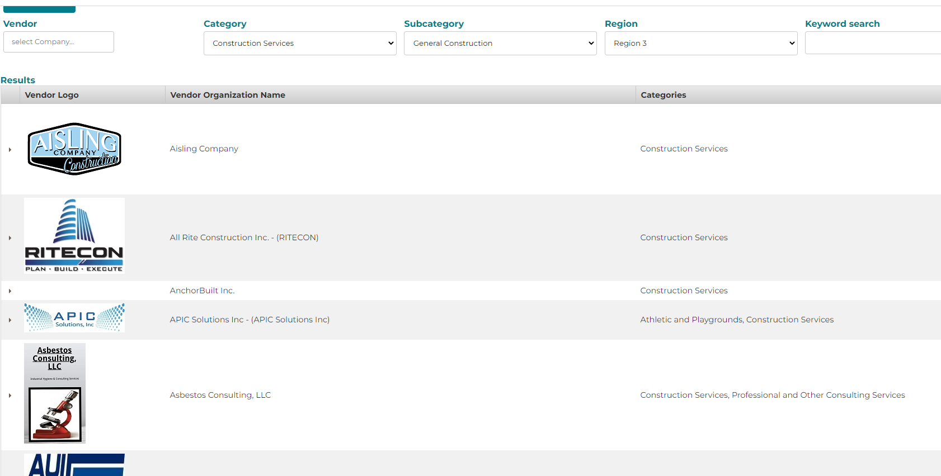
Once you have filled in category subcategory and region

Slide 14
7. To find information once you want to research a particular vendor click on the vendors name or logo
a. This will open the vendor description, general contact information (Address, contact name, phone #, web site).
b. You will also see a listing of one or more contracts.
c. You can click on a contract number to get more detailed information.
  i. Once you click on a contract number, it will take you to an "overview" page.
  ii. In the upper left corner, click on the vendor name, under the word "overview"
  iii. This will open a page where you can find:

Slide 15
You will find
1. The actual contract agreement (your purchasing department will want this document)
2. Pricing files and estimates for goods and services.
3. Contract information for this particular contract.
4. Additional files for the purchasing office, such as
    a. W-9
    B. Certificates of Liability Insurance
    PLEASE CHECK WITH YOUR PURCHASING DEPARTMENT TO DETERMINE THEIR PROCESS FOR PURCHASING VIA CES

Slide 16
For Assistance, Please Contact
Paul Benoit, CES North Services
(575) 760-9002
paul@ces.org
Jim Barentine, CES South Services
(602) 689-0000
jim@ces.org

